Slide 1
Store Sales Prediction

Slide 2
Store Sales Prediction
Objective:
To build a solution that should able to predict the sales of the different stores of Big Mart.
Benefits:
Help determine the sales.
gives the ability to make informed business decisions and develop data-driven strategies
Easy to predict the sales information based on user data.

Slide 3
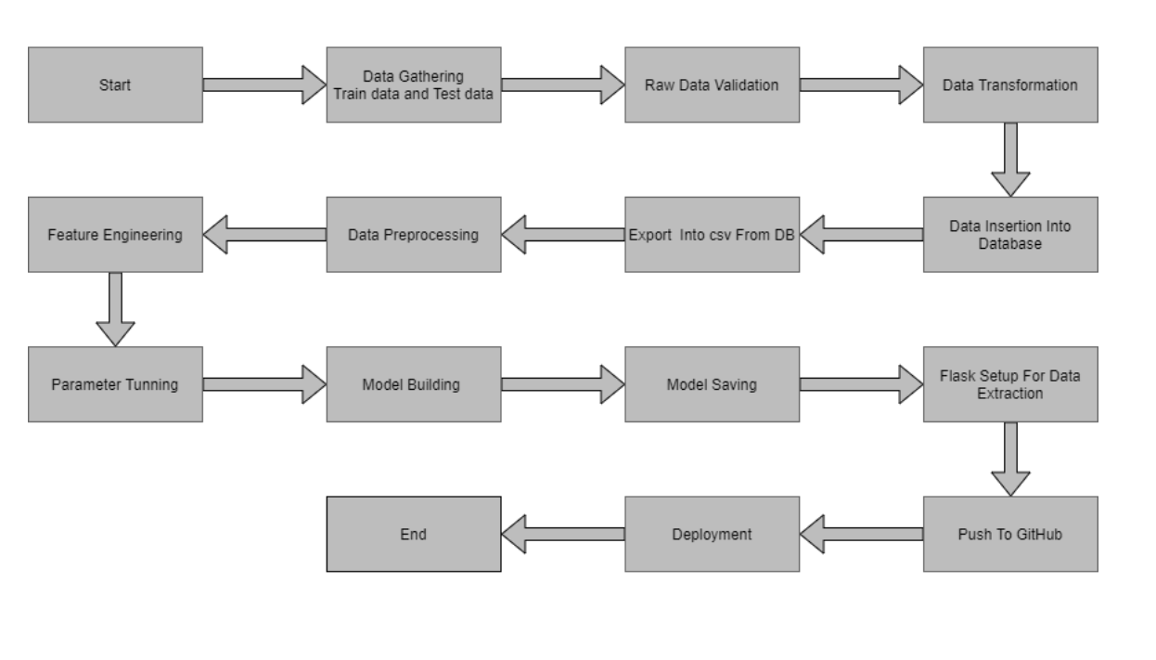
Architecture

Slide 4
Data validation and Data transformation
Item_Identifier: Unique product ID
Item_Weight: Weight of product. It should be greater than 0.
Item_Fat_Content: Whether the product is low fat or not
Item_Visibility: The % of total display area of all products in a store allocated to the particular product. It should range between 0 to 1.
Item_Type: The category to which the product belongs
Item_MRP: Maximum Retail Price (list price) of the product. It should be greater than 0.
Outlet_Identifier: Unique store ID
Outlet_Establishment_Year: The year in which store was established
Outlet_Size: The size of the store in terms of ground area covered
Outlet_Location_Type: The type of city in which the store is located.
Outlet_Type: Whether the outlet is just a grocery store or some sort of supermarket.
Item_Outlet_Sales: Sales of the product in the particular store. This is the outcome variable to be predicted.

Slide 5
Data Pre-processing
Data preprocessing is the process of transforming raw data into an understandable format. It is also an important step in data mining as we cannot work with raw data. The quality of the data should be checked before applying machine learning or data mining algorithms.
Training data get from kaggle project in .csv format.
Performing EDA to get insight of data like identifying distribution , outliers ,trend among data etc.
Check for null values in the columns. If present functions are performed to fill them.
Encode the categorical values with numeric values.

Slide 6
Model Building
A machine learning model is built by learning and generalizing from training data, then applying that acquired knowledge to new data it has never seen before to make predictions and fulfill its purpose.
We use RandomForestRegressor for building the model.
Predict the value using this model and find the mean absolute error and mean squared error
GrideSearchCV used for parameter tuning with estimators values.
Save the model as grid_rbgr.pkl.
Load the model for prediction.

Slide 7
Prediction
Train data is saved in .csv format.
Perform data pre-processing technique on it.
Develop the model grid_rbgr.pkl.
Later this pickle file is used for prediction.

Slide 8
Q & A
Q1) What’s the source of data?
Ans. The data for training is provided by the client in kaggle:
https://www.kaggle.com/brijbhushannanda1979/bigmart-sales-data
Q 2) What was the type of data?
Ans. The data was the combination of numerical and Categorical values.
Q 3) What’s the complete flow you followed in this Project?
Ans. Refer the Architecture section for this.

Slide 9
Q & A
Q 4) What techniques were you using for data pre-processing?
Removing unwanted attributes
Visualizing relation of independent variables with each other and output variables
Removing outliers
Cleaning data and imputing if null values are present.
Converting categorical data into numeric values.
Q 5) How training was done or what models were used?
Before diving the data in training and validation set we performed clustering over fit to divide the data into clusters. As per cluster the training and validation data were divided. The scaling was performed over training and validation data. Algorithm Random forest regressor is used .

Slide 10
Q & A
Q 6) How Prediction was done?
Ans. The tested files are load in to the drive. We pass its data to the best model which we have saved in .pkl format and get the prediction.
Q 7) Where the model was deployed?
Ans. When the model is ready, we deploy it in Google cloud platform. This model is an web application where user can enter the data and these data gets extracted in the backend and user gets the prediction result.

